Slide 1
Chapter 4
Cellular Metabolism and Metabolic Disorders

Slide 2
Outlines
Metabolism
Central metabolic pathways (glycolysis, kreb‘s cycle and electron transport chain)
Nature and role of enzymes involved in metabolism
Photosynthesis
Metabolic disorders

Slide 3
Cellular Metabolism
Living cells are in a constant activity
How living organisms or their cells extract energy from their environments? Through metabolism
Metabolism is the sum of chemical reactions that takes place within each cell of a living organisms.
It provides energy for vital processes and synthesizing of new organic materials.

Slide 4
Cont’d
These reactions can be divided into:
Catabolic reactions: convert nutrients to energy
release energy by breaking down larger molecules into smaller molecules
Anabolic reactions: lead to the synthesis of larger biomolecules.
use the energy released by catabolic pathways to build larger molecules from smaller molecules

Slide 5
Cont’d
In metabolism, a series of chemical reactions in which the product of one reaction is the substrate for the next reaction is a metabolic pathway.
The reactants and products of these chemical reactions are metabolites.
The major classes of metabolites include proteins, carbohydrates, nucleotides, lipids, coenzymes, and cofactors.

Slide 6
Enzymes and their role in metabolism
Most chemical reactions within cells do not occur spontaneously. Instead, they need a catalyst to get them started.
Enzymes are protein catalysts that speed up biochemical reactions by facilitating the molecular rearrangements that support cell function.
Almost all metabolic processes in the cell need enzyme catalysis.

Slide 7
Cont’d
Enzymes bind with particular reactants until the chemical reaction occurs, then free themselves.
Enzymes speed up reactions by lowering activation energy.
Many enzymes change shape when substrates bind. This is termed "induced fit", meaning that the precise orientation of an enzyme required for catalytic activity can be induced by the binding of the substrate

Slide 8
Chemical nature and classification of enzymes
All known enzymes are proteins with the exception of recently discovered RNA enzymes.
Some enzymes require no chemical groups for activity other than their amino acid residues
Others require an additional chemical component called a cofactor-either one or more inorganic ions, such as Fe²⁺ , Mg^{2+ ,} Mn²⁺ or Zn²⁺ or

Slide 9
Cont’d
a complex organic or metallo-organic molecule called coenzyme which act as transient carriers of specific functional groups
This entire active complex is referred to as holoenzyme; i.e., apoenzyme (protein portion) plus the cofactor (coenzyme, prosthetic group or metal-ion-activator).
Only a restricted region of the enzyme molecule actually binds to the substrate- active site

Slide 10
Cont’d
Based on differences in chemical nature, they classified as:
1. Simple enzymes: are made up of only protein (polypeptide). They contain no chemical groups other than amino acid residues. Digestive enzymes such as pepsin and trypsin are of this nature.
2. Conjugate Enzymes: It is an enzyme which is formed of two parts – a protein part (apoenzyme (e.g., flavoprotein)) and a non-protein part (cofactor).
The complete conjugate enzyme, consisting of an apoenzyme and a cofactor, is called holoenzyme.

Slide 11
3. Metallo-enzymes: The metal cofactors involved in enzymatic reactions are monovalent (K⁺) and divalent cations (Mg⁺⁺, Mn⁺⁺ and Cu⁺⁺).
If the metal forms part of the molecule, as iron of haemoglobin or cytochrome is, the enzymes are called metallo-enzymes.
4. Isoenzymes (Isozymes): multiple forms of same enzyme that differ in physical and chemical catalyze the same chemical rxn.
At one time it was believed that an organism has only a single enzyme for a given step of a metabolic reaction. It was later discovered that a substrate may be acted upon by a number of variants of an enzyme producing the same product.

Slide 12
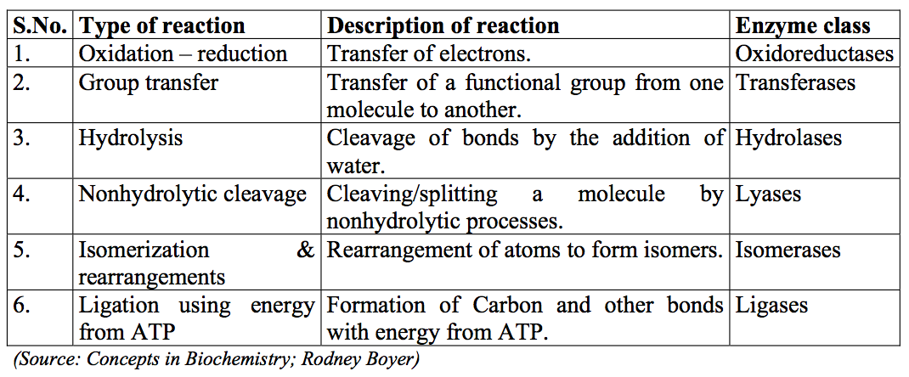
Classes of enzymes based on the substrate they act up on

Slide 13
Mechanisms of enzyme action
Mechanisms of enzyme catalysis vary, but are all similar in principle to other types of chemical catalysis.
An enzyme attracts substrates to its active site, catalyzes the chemical reaction by which products are formed.
The combination formed by an enzyme and its substrates is enzyme–substrate complex.
The substrates are attracted to the active site by electrostatic and hydrophobic forces, which are called non-covalent bonds.

Slide 14
Cont’d
Model of enzyme action
Lock and Key Enzyme Model: an enzyme is assumed to be the lock and the substrate the key
The enzyme and substrate are made to fit exactly
This model fails to take into account proteins conformational changes to accommodate a substrate molecule
The induced-fit model of enzyme action assumes that the enzyme active site is more a flexible pocket whose conformation changes to accommodate the substrate molecule .

Slide 15
Factors affecting enzymatic activities
The activity of an enzyme is affected by its environmental conditions
Temperature
Optimal temperature is the characteristic T⁰ at which an enzyme has the maximal catalytic power
Increasing temperature increases the kinetic energy that molecules possess.
Increasing temperature increases the rate of reaction, forming more product.
However, increasing temperature also increases the vibrational energy that molecules have and denature the enzyme

Slide 16
pH - Acidity and Basicity
Optimal pH is the characteristic pH at which the enzyme has the maximal catalytic power
pH7.0 is suitable for most enzymes
pH is a measure of the hydrogen ion (H⁺) concentration therefore a good indicator of the hydroxide ion (OH⁻) concentration.
Lower pH values mean higher H⁺ concentrations and lower OH⁻ concentrations.

Slide 17
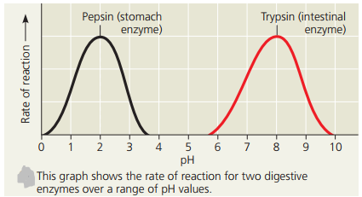
Note: Read Enzyme kinetics to understand more about factors affect enzyme activity

Slide 18
Substrate concentration
Increasing substrate concentration increases the rate of reaction.
This is because more substrate molecules will be colliding with enzyme molecules
So more product will be formed.
Enzyme concentration
Increasing enzyme concentration will increase the rate of reaction
as more enzymes will be colliding with substrate molecules.

Slide 19
Enzyme inhibitors
Inhibitors are certain molecules that can decrease the catalytic rate of an enzyme-catalyzed reaction
Inhibitors can be normal body metabolites or foreign substances (drugs and toxins)
The inhibition process can be either reversible or irreversible
Reversible inhibitors are bound to enzymes non-covalently
Irreversible Inhibitors are covalently bound to the essential groups of enzymes

Slide 20
1. Reversible inhibition
1.1. Competitive inhibition:- occurs when molecules very similar to the substrate molecules bind to the active site and prevent binding of the actual substrate.
share the structural similarities with that of substrates
compete for the active sites with the normal substrates
E.g. Penicillin for example, is a competitive inhibitor that blocks the active site of an enzyme that many bacteria use to construct their cell walls.

Slide 21
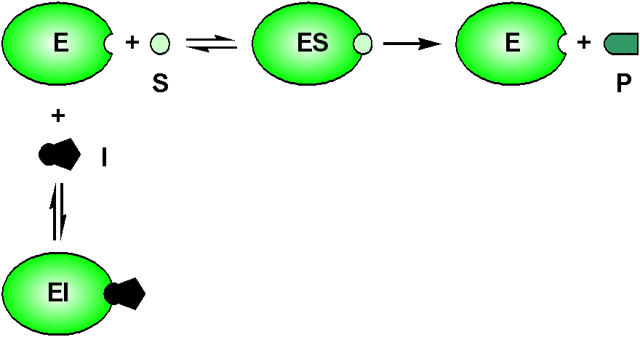
Competitive inhibition

Slide 22
Reversible inhibition cont’d
1.2. Noncompetitive inhibition:- occurs when an inhibitor binds to the enzyme at a location other than the active site on the free enzymes or the E-S complexes..
It prevent from reacting with its substrate.
The E-I complex formation does not affect the binding of substrates
The E-I-S complexes do not proceed to form products
type of noncompetitive inhibition is called allosteric inhibition

Slide 23
the place where the inhibitor binds to the enzyme is called the allosteric site.
Activators:- Activators are the compounds which bind to an enzyme or an enzyme-substrate complex to enhance the enzymatic activity without being modified by the enzymes
Allosteric control can involve stimulation of enzyme action as well as inhibition.
An activator molecule can be bound to an allosteric site and induce a reaction at the active site by changing its shape to fit a substrate

Slide 24
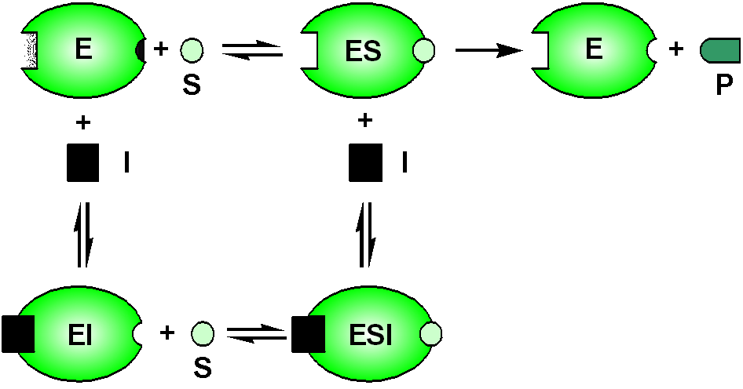
Noncompetitive inhibition

Slide 25
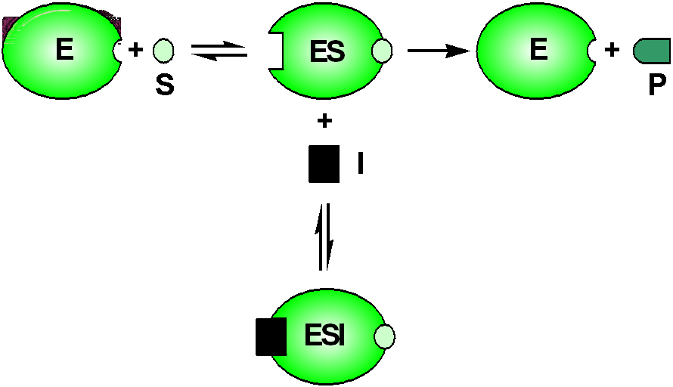
1.3. Uncompetitive inhibitors
only recognize and interact with ES
Thus to exhibit enzyme binding, uncompetitive inhibitors require formation of ES

Slide 26
2. Irreversible inhibition
Irreversible inhibitors usually covalently modify an enzyme and can therefore not be reversed.
It often contain reactive functional groups.
Specific for one class of enzyme and do not inactivate all proteins
They do not function by destroying protein structure but by specifically altering the active site of their target
Cannot be removed with simple dialysis or super-filtration

Slide 27
Bioenergetics and biosynthesis Cellular respiration
Most living organisms obtain energy by breaking down organic molecules (catabolism) during cellular respiration.
The function of cellular respiration is to harvest electrons from carbon compounds, such as glucose and to make Adenosine Tri-phosphate (ATP).
Cellular respiration occurs in two main parts:
Glycolysis :- is an anaerobic process.
- do not require oxygen.
2. Aerobic respiration:- it includes the Krebs cycle and electron transport chain which require oxygen.

Slide 28
1. Glycolysis
Is the process of degradation of glucose, which breaks down glucose to pyruvate.
The main purpose of glycolysis is the generation of energy (ATP).
but much more ATP is formed downstream of glycolysis through the complete oxidation of pyruvate.
Found in animals, plants and microorganisms.
Used by anaerobic as well as aerobic organisms.
The process takes place in the cytoplasm of prokaryotes and eukaryotes

Slide 29
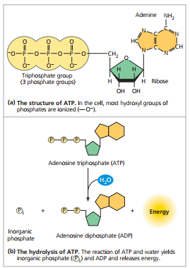

Slide 30
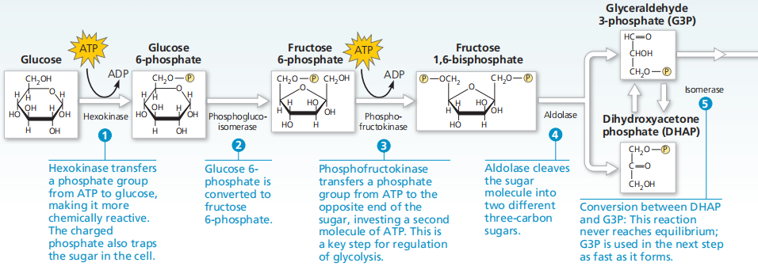
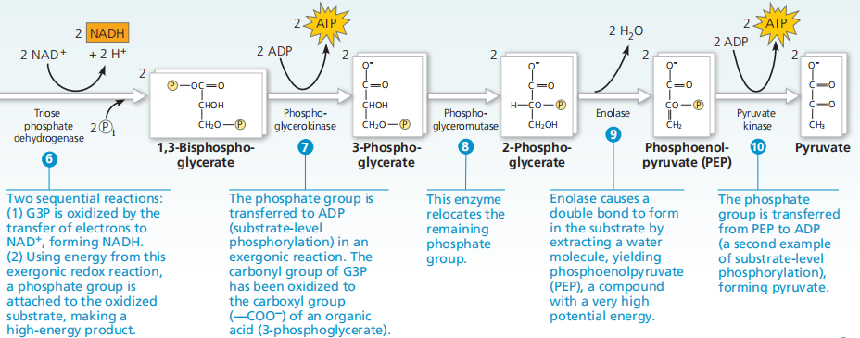

Slide 31
It involves ten enzymatic reactions as described below:
The phosphorylation of glucose at carbon-6 by hexokinase forming glucose 6-phosphate (G6P).
The conversion of glucose-6-phosphate(G6P) to fructose-6-phosphate(F6P) by phosphohexose isomerase
The phosphorylation of fructose-6-phosphate to the 1,6-bisphosphate by phospho-fructokinase
The cleavage of fructose-1,6-bisphosphate by aldolase. This yields two different products, dihydroxyacetone phosphate and glyceraldehyde-3-phosphate

Slide 32
5. The isomerization of dihydroxyacetone phosphate to a second molecule of glyceraldehyde-3-phosphate by triose phosphate isomerase
6. The dehydrogenation and concomitant phosphorylation of glyceraldehyde-3-phosphate to 1,3-bis-phosphoglycerate by glyceraldehyde-3-phosphate dehydrogenase
7. The transfer of the 1-phosphate group from 1,3-bis-phosphoglycerate to ADP by phosphoglycerate kinase, which yields ATP and 3-phosphoglycerate

Slide 33
8. The isomerization of 3-phosphoglycerate to 2phosphoglycerate by phosphoglycerate mutase(PGAM)
9. The dehydration of 2-phosphoglycerate to phosphoenol pyruvate by enolase.
10. The transfer of the phosphate group from phosphoenol pyruvate to ADP by pyruvate kinase, to yield a second molecule of ATP.

Slide 34
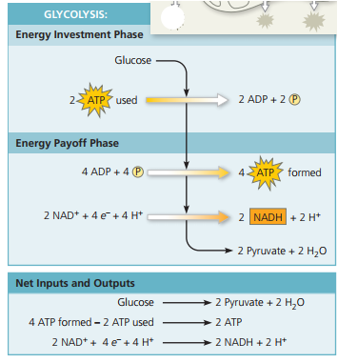

Slide 35
TCA cycle and ETC: Aerobic respiration
One fate of pyruvate enters TCA cycle is to complete oxidation.
But there are intermediate processes that convert pyruvate to a acetyl coA.
The enzyme complex converts pyruvate into Acetyl-CoA by the following chemical changes:
Decarboxylation of pyruvate (loss of CO₂)
Formation of acetyl group
Linkage of acetyl group to coenzyme A forming acetyl - CoA.

Slide 36
2. The Tricarboxylic Acid (TCA) Cycle
Prior to the Krebs cycle, pyruvate reacts with coenzyme A (CoA) to form a 2-carbon intermediate called acetyl CoA.
At the same time, carbon dioxide is released and NAD is converted to NADH
Acetyl CoA then moves to the mitochondrial matrix. The reaction results in the production of two carbon dioxide molecules and two NADH.

Slide 37
Krebs cycle cont’d
The TCA cycle also called Krebs or Citric acid cycle, is considered as central pathway of aerobic metabolism
It serves for two purposes-bioenergetics and biosynthesis
Bioenergetic:
The cycle carries out complex degradation of acetyl group in acetyl - CoA to CO₂, resulting in release of energy (ATP or GTP) and reducing power (NADH and FADH₂).
2. Biosynthesis: - It supplies precursors for several biosynthetic pathways of amino acids, pyrimidines, purines etc.

Slide 38
Krebs cycle cont’d
The Krebs cycle begins with acetyl CoA combining with a 4-carbon compound to form a 6-carbon compound known as citric acid.
Citric acid is then broken down in the next series of steps, releasing 2CO₂ and generating one ATP, three NADH, and one FADH₂ from single cycle.
Finally, acetyl CoA and citric acid are generated and the cycle continues.

Slide 39
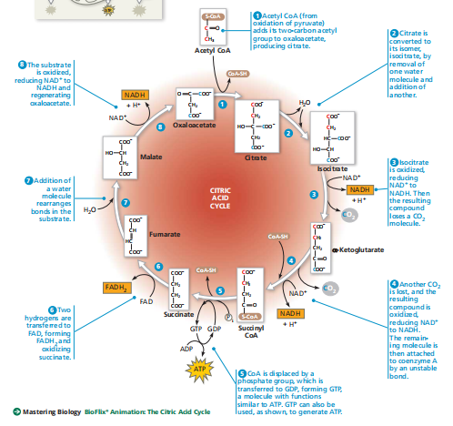

Slide 40
Krebs cycle cont’d
2. Biosynthesis: - It supplies precursors for several biosynthetic pathways.
TCA cycle is also an important source of biosynthetic precursors
α-ketoglutarate and oxaloacetate are used for synthesis of a number of amino acids like glutamic acid, asparatic acid
Succinyl - CoA is used to form porphyrin ring of cytochromes, chlorophyll
Oxaloacetate can also be converted to phosphoenolpyruvate, which is a precursor of glucose.
Acetyl - CoA is the starting material for fatty acid biosynthesis.

Slide 41
Electron Transport Chain
It is the final step in the break-down of glucose and point at which most of the ATP is produced.
Process by which ATP synthase phosphorylate ADP into ATP in electron transport chain is oxidative phosphorylation
Oxygen is the final electron acceptor in ETC.
Protons and electrons are transferred to oxygen to form water.
Occurs within the cell membrane of bacteria/ in inner membrane of mitochondria of eukaryotic organisms

Slide 42
ETC cont’d
Energy in the form of electrons released in stepwise from reduced energy carrier molecules
The NADH formed during glycolysis, and the NADH and FADH₂ molecules formed in Krebs cycle are used to reduce oxygen and generate high energy ATP molecule.
ATP is generated from the oxidation of NADH and FADH₂ and the subsequent transfer of electrons and pumping of protons
Pumping of protons powered by electron transport with O₂ as terminal electron acceptor yield ATP

Slide 43
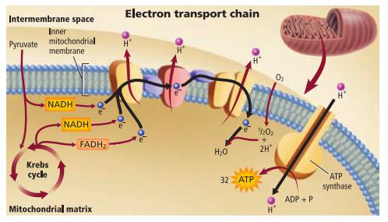
Fig: Electron Transport Chain

Slide 44
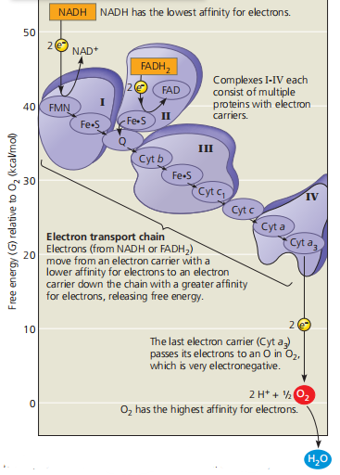

Slide 45
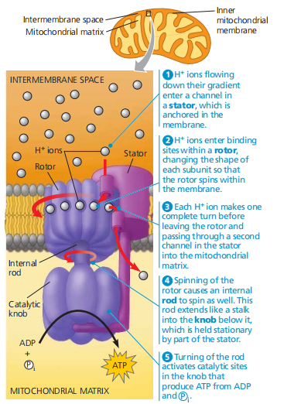

Slide 46
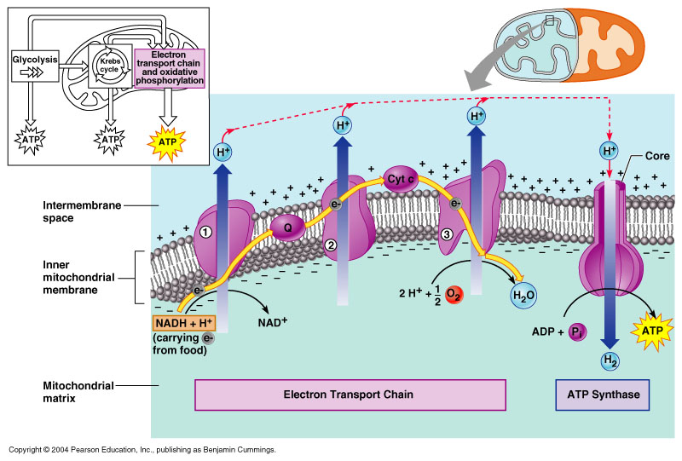
Video link: C:\Users\TOSHIBA\Downloads\The Electron Transport Chain Explained (Aerobic Respiration).mp4
Chemiosmosis
Electrons are transferred from complex to complex and
some of their energy is used to pump protons (H⁺) into the
intermembrane space, creating a proton gradient.
ATP synthesis is powered by the
flow of H⁺ back across the inner
mitochondrial membrane through
ATP synthase.

Slide 47
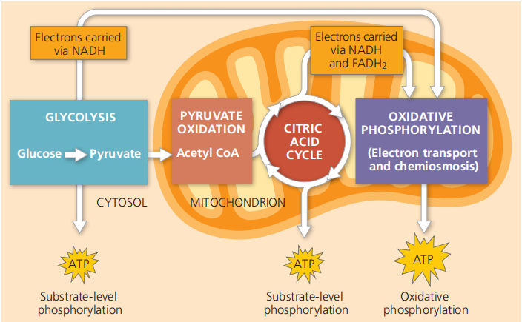

Slide 48
Biosynthesis
It is a multi-step, enzyme-catalyzed process where substrates are converted into more complex products in living organisms.
In biosynthesis, simple compounds are modified, converted into other compounds, or joined together to form macromolecules.
The prerequisite elements for biosynthesis includes:
Precursor compounds, chemical energy (e.g. ATP), and
Catalytic enzymes which may require coenzymes (e.g. NADH, NADPH).

Slide 49
Photosynthesis
C:\Users\TOSHIBA\Downloads\Photosynthesis_ Light Reaction, Calvin Cycle, and Electron Transport.mp4
Video link: https://youtu.be/KfvYQgT2M-k
Photosynthesis is a process by which green plants, algae and chlorophyll containing bacteria utilize the energy of sunlight to synthesize their own food (organic matters) from simple inorganic molecules.
It represented by :

Slide 50



Cont’d
During oxygenic photosynthesis light energy transfers electrons from water (H₂O) to carbon dioxide (CO₂), to produce carbohydrates.
Anoxygenic photosynthesis uses other electron donors than water. The process typically occurs in bacteria such as purple bacteria and green sulfur bacteria, which are primarily found in various aquatic habitats.

Slide 51
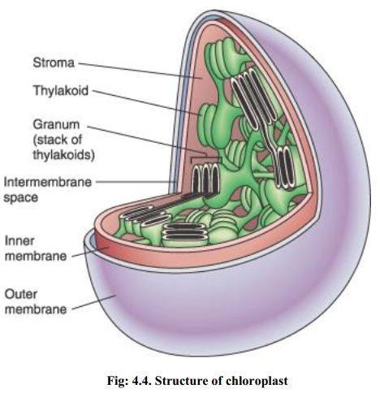

Slide 52
The importance of photosynthesis
It is essential to all life on earth.
It is the only biological process that captures energy from outer space (sunlight) and Converts it into chemical energy in the form of Glyceraldehyde3-phosphate (G3P) which in turn can be made into sugars and other organic compounds such as proteins, lipids, and nucleic acids
Therefore, photosynthesis powers 99% of Earth‘s ecosystems.

Slide 53
The photosynthetic apparatus
Plastids
Photosynthetic eukaryotic organisms contain organelles called plastids in their cytoplasm.
Plastids contain pigments or can store important chemicals (nutrients) used by the cells.

Slide 54
Cont’d
Pigments
It is a substance that absorb visible light
Different pigments absorb light of different wavelengths, and the wavelengths that are absorbed disappear.
If a pigment is illuminated with white light, the color we see is the color most reflected or transmitted by the pigment (If a pigment absorbs all wavelengths, it appears black)
We see green when we look at a leaf because chlorophyll absorbs violet-blue and red light while transmitting and reflecting green light

Slide 55
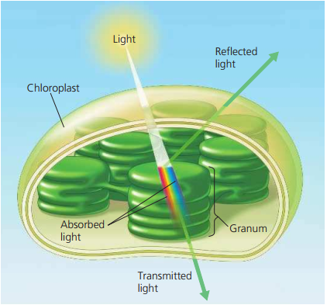
The chlorophyll molecules of chloroplasts absorb violet-blue and red light (the colors most effective in driving photosynthesis) and reflect or transmit green light.

Slide 56
The three main groups of Pigments
1. Chlorophylls:- these green-colored pigments are capable of trapping blue and red light, resides in the thylakoid membranes of the chloroplast.
Chlorophylls have three subtypes, chlorophyll a, chlorophyll b and chlorophyll c.
2. Carotenoids: these red, orange or yellow-colored pigments absorb bluish-green light. E.g. carotenoids are xanthophyll (yellow)
3. Phycobilins: These red or blue pigments absorb wavelengths of light that are not as well absorbed by chlorophylls and carotenoids. They are seen in cyanobacteria and red algae.
Reaction centers are pigment and proteins which convert light energy to chemical energy and begin the process of electron transfer

Slide 57
The photosynthetic process
Are divided into two:
Both types of reactions take place in chloroplasts.
1. Light-dependent reactions (light reactions): When a photon of light hits the reaction center, a pigment molecule such as chlorophyll releases an electron.
Is takes place in the thylakoid
Steps of photosynthesis that convert solar energy to chemical energy.

Slide 58
Light reaction cont’d
Water is split, providing a source of electrons and protons (H⁺) and giving off O₂ as a by-product.
The light reactions use solar energy to reduce NADP + to NADPH by adding a pair of electrons along with an H⁺.
Generate ATP by photophosphorylation

Slide 59
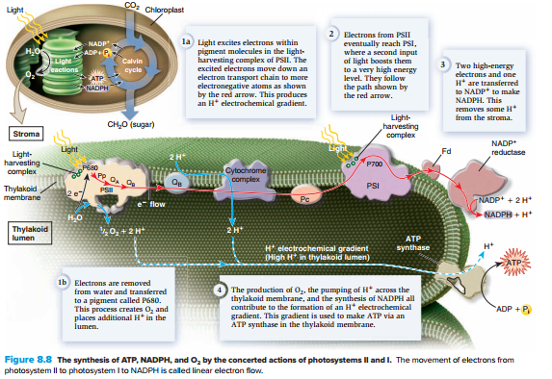

Slide 60
The photosynthetic process cont’d
2. Light-independent reactions (dark reactions/Calvin cycle): Light reactions produce ATP and NADPH, which are the rich energy sources that drive dark reactions.
The reactions is takes place in the stroma.
Although NADPH and ATP provide cells with large amounts of energy, these molecules are not stable enough to store chemical energy for long periods of time. Thus, there is a second phase of photosynthesis called the Calvin cycle in which energy is stored in organic molecules such as glucose.

Slide 61
Cont’d
Three chemical reaction steps make up the Calvin cycle
Carbon fixation: joining of CO₂with other organic molecules
six carbon dioxide molecules combine with six 5-carbon compounds to form twelve 3- carbon molecules 3-phosphoglycerate (3-PGA).
Reduction: the chemical energy stored in ATP and NADPH is transferred to the 3-PGA molecules to form high-energy molecules called glyceraldehyde 3-phosphates (G3P).
ATP supplies the phosphate groups for forming G3P molecules, while NADPH supplies hydrogen ions and electrons
The source of NADPH and ATP for Calvin cycle is the light reactions.

Slide 62
Cont’d
Regeneration: two G3P molecules leave the cycle to be used for the production of glucose and other organic compounds.
In the final step of the Calvin cycle, an enzyme called rubisco converts the remaining ten G3P molecules into 5-carbon molecules called ribulose 1, 5-bisphosphates (RuBP).
These molecules combine with new carbon dioxide molecules to continue the cycle.

Slide 63
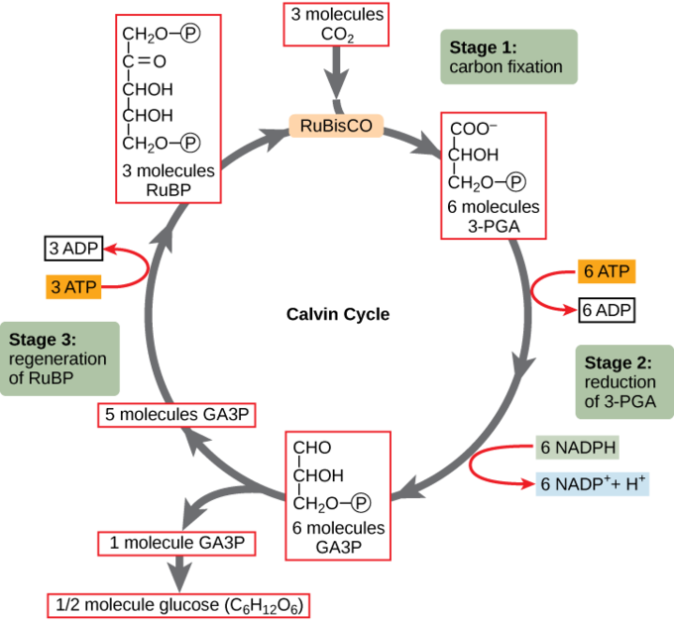

Slide 64
Alternative Pathways photosynthesis
The environment in which an organism lives can impact the organism‘s ability to carry out photosynthesis.
Environments in which the amount of water or carbon dioxide available is insufficient can decrease the ability of a photosynthetic organism to convert light energy into chemical energy.
For example, plants in hot, dry environments are subject to excessive water loss that can lead to decreased photosynthesis. Many plants in extreme climates have altered native photosynthesis pathways to maximize energy conversion.

Slide 65
Alternative Pathways photosynthesis cont’d
C4 pathway
Helps plants maintain photosynthesis while minimizing water loss
Occurs in plants such as sugar cane and corn called C4 plants b/c they fix carbon dioxide into four-carbon compounds instead of three-carbon molecules during the Calvin cycle.
Keep their stomata (plant cell pores) closed during hot days, while the four carbon compounds are transferred to special cells where CO₂ enters the Calvin cycle

Slide 66
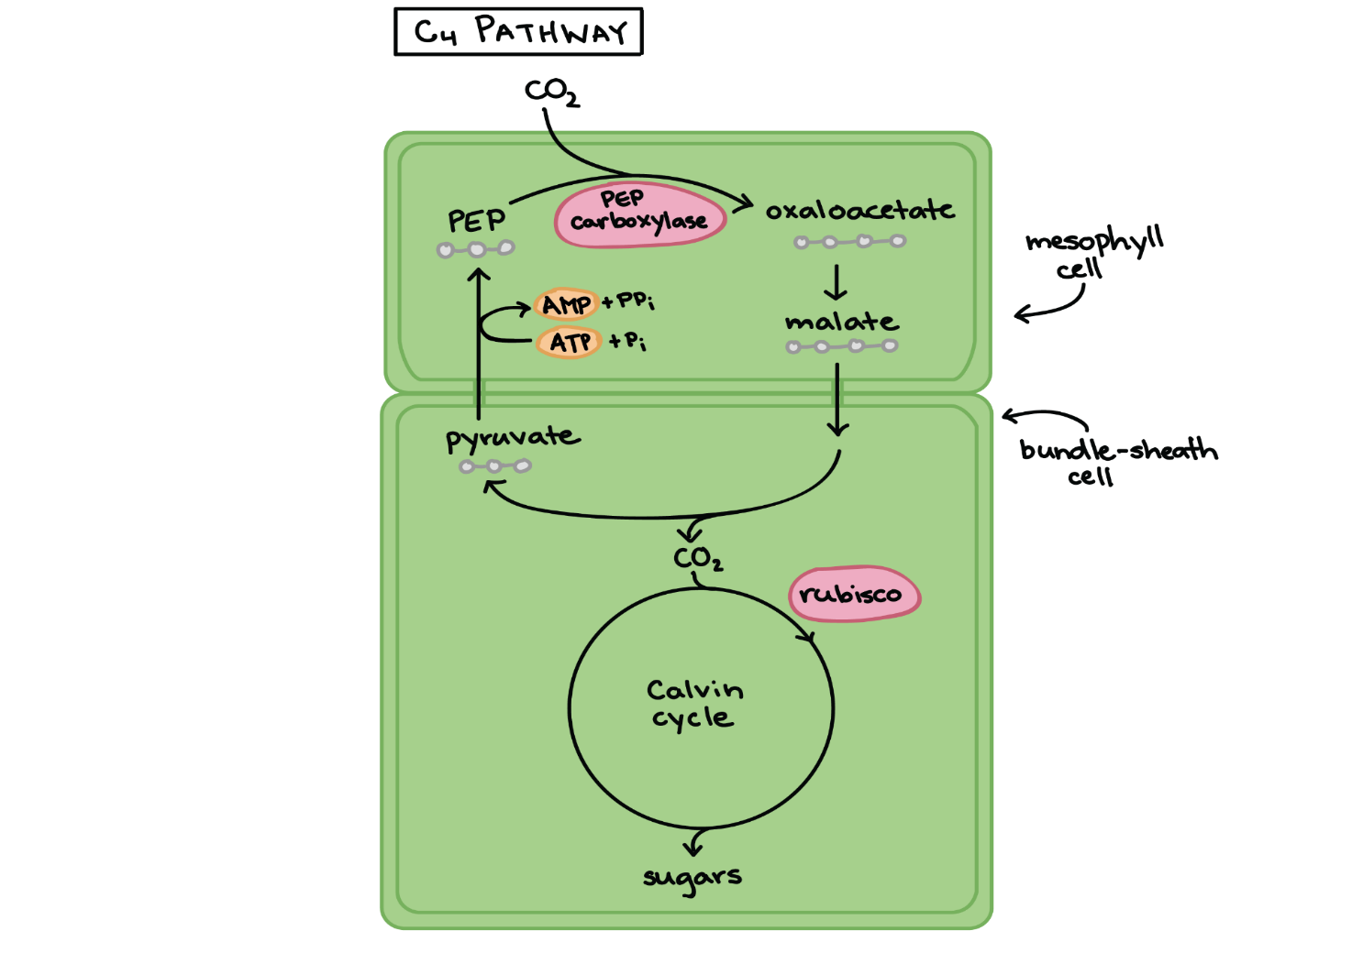
This allows for sufficient carbon dioxide uptake, while simultaneously minimizing water loss.
Most efficient in conditions of low carbo dioxide concentration, high light intensity and high temperature

Slide 67
Alternative Pathways photosynthesis cont’d
Crassulacean acid metabolism (CAM)
Some plants that are adapted to dry environments, such as cacti, orchids and pineapples use this pathway to minimize photorespiration
Occurs in water conserving plants that live in deserts, salt marshes, and other environments where access to water is limited.
Allow carbon dioxide to enter the leaves only at night, when the atmosphere is cooler and more humid.

Slide 68
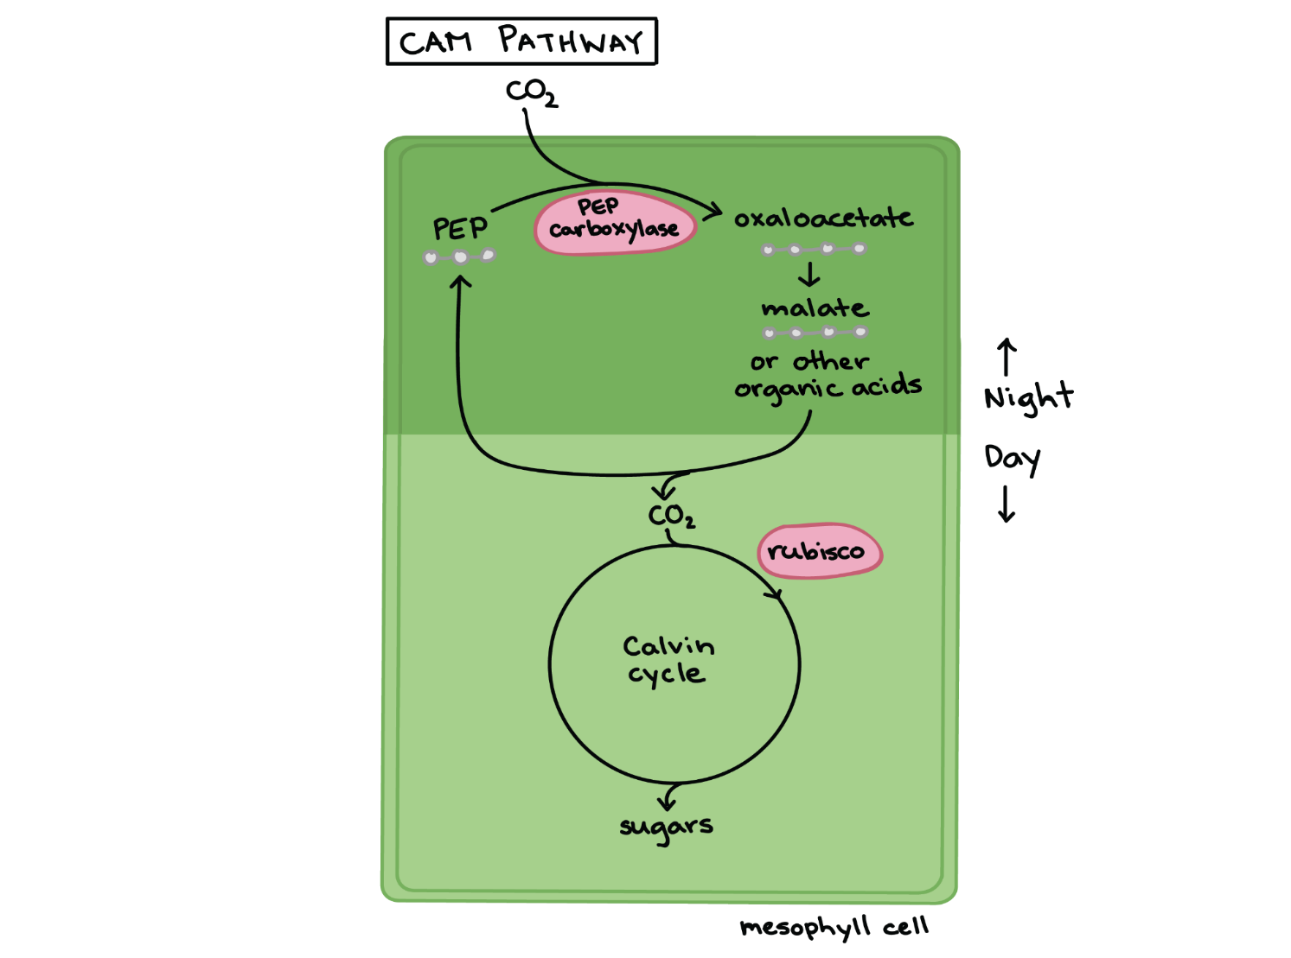
Fix carbon dioxide into organic compounds at night
During the day, carbon dioxide is released from these compounds and enters the Calvin cycle.
This pathway also allows for sufficient carbon dioxide uptake, while minimizing water loss

Slide 69
Metabolic disorders, diagnosis and treatments
Metabolism is the breaking down of food to its simpler components: proteins, carbohydrates (or sugars), and fats.
Metabolic disorders occur when these normal processes become disrupted.
Disorders in metabolism can be inherited(inborn errors of metabolism) or may be acquired during your lifetime.

Slide 70
Inherited metabolic disorders
Inherited metabolic disorders are one cause of metabolic disorders, and
occur when a defective gene causes an enzyme deficiency.
These diseases, are many subtypes, are known as inborn errors of metabolism.
Metabolic diseases can also occur when the liver or pancreas do not function properly.

Slide 71
Examples of inherited metabolic disorders include:
Can be classified based on the type of food-related building block that they affect
Carbohydrate disorders: include Diabetes insipidus, hereditary fructose intolerance, galactosemia, pyruvate metabolism disorders, von Gierke‘s disease, McArdle disease, Pompe‘s disease, and Forbes‘ disease
Fatty acid oxidation defects: include Gaucher‘s disease, Niemann-Pick disease, Fabry‘s disease, and medium-chain acyl-coenzyme A dehydrogenase (MCAD) deficiency

Slide 72
Amino acid disorders; examples include Tay-Sachs disease, phenylketonuria, tyrosinemia, maple syrup urine disease, and homocystinuria
Acid-base imbalance, Disorders of calcium metabolism, DNA repair-deficiency disorders, Iron metabolism disorders, Mitochondrial diseases, Phosphorus metabolism disorders and etc.

Slide 73
Other causes of metabolic disorders
Metabolic disorders can be a combination of inherited and environmental factors. It includes like:
Alcohol abuse, Diabetes (chronic disease that affects your body‘s ability to use sugar for energy)
Diuretic abuse, Gout (type of arthritis caused by a buildup of uric acid in the joints)
Ingestion of poison or toxins, including excessive aspirin, bicarbonate, alkali, ethylene glycol, or methanol
Kidney failure, Pneumonia, respiratory failure, or collapsed lung
Sepsis (life-threatening bacterial blood infection)

Slide 74
Diagnosis of metabolic disorders
Metabolic syndrome is more effectively diagnosed by testing different:
Blood markers (specific markers of insulin resistance),
Obesity (especially abdominal obesity), high blood pressure, and lipid abnormalities.

Slide 75
Cont’d
Specifically, metabolic syndrome is diagnosed if any three of the following five markers are present:
Elevated waist circumference: 40 inches or more for men; 35 inches or more for women
Elevated triglycerides: 150 mg/dL or higher
Reduced high-density lipoprotein (HDL) levels (AKA ''good'' cholesterol): less than 40 mg/dL in men; less than 50 mg/dL in women
Elevated blood pressure: 130/85 mm Hg or higher or are already taking blood pressure medications
Elevated fasting glucose: 100 mg/dL or higher or are already taking glucose-lowering medications

Slide 76
Treatments of metabolic disorders
Inherited metabolic disorders are often treated with:
Nutritional counseling and support,
Periodic assessment,
Physical therapy, and
other supportive care options.

